Slide 1
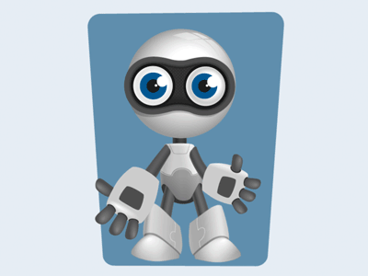
Welcome to Robotics 2021!
Where we build stuff in order to make stuff and learn stuff along the way.

Slide 2

This Photo by Unknown Author is licensed under CC BY-SA-NC

Slide 3

This Photo by Unknown Author is licensed under CC BY

Slide 4
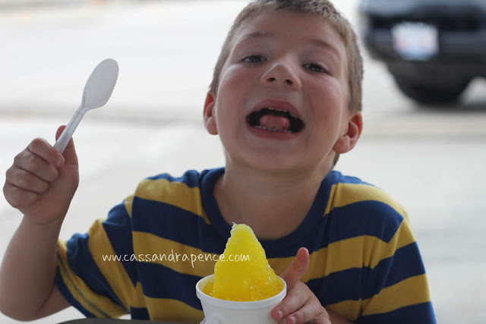
This Photo by Unknown Author is licensed under CC BY-ND

Slide 5
What Are We Building?

Slide 6
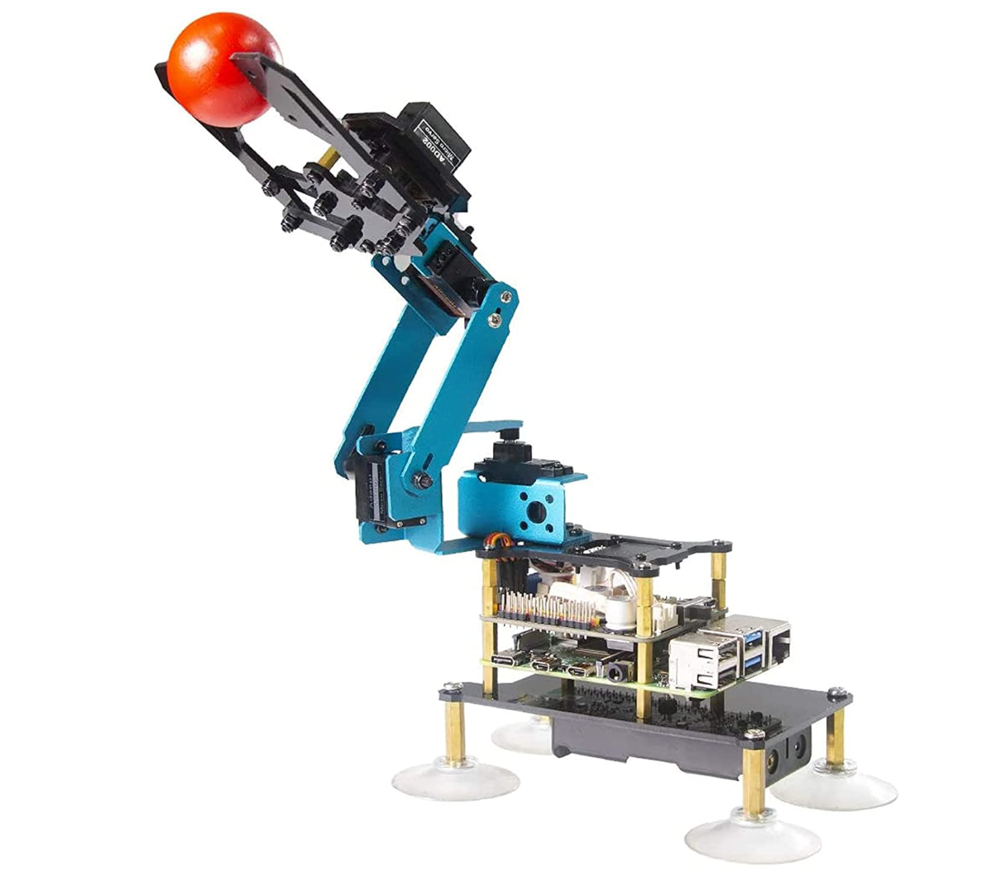
Project #1
Build a robotic arm.
Control it.
Pick up lego bricks.
Put them down again.

Slide 7
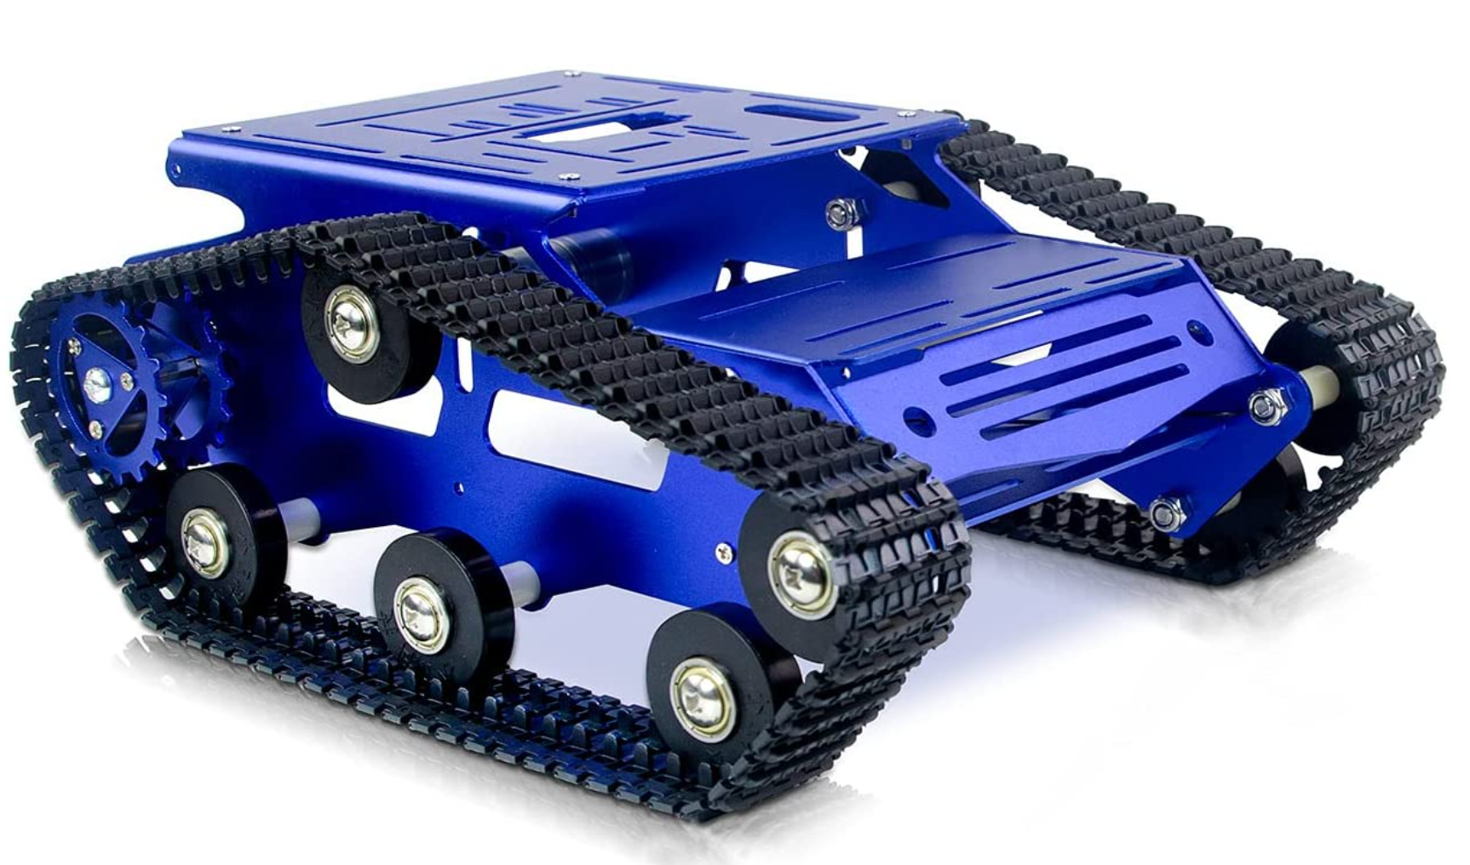
Project #2
Build a tank-steering vehicle.
Learn to drive it.
Learn to follow a line.
Transport lego bricks and dump them.

Slide 8
Six Robotics Teams
6

Slide 9
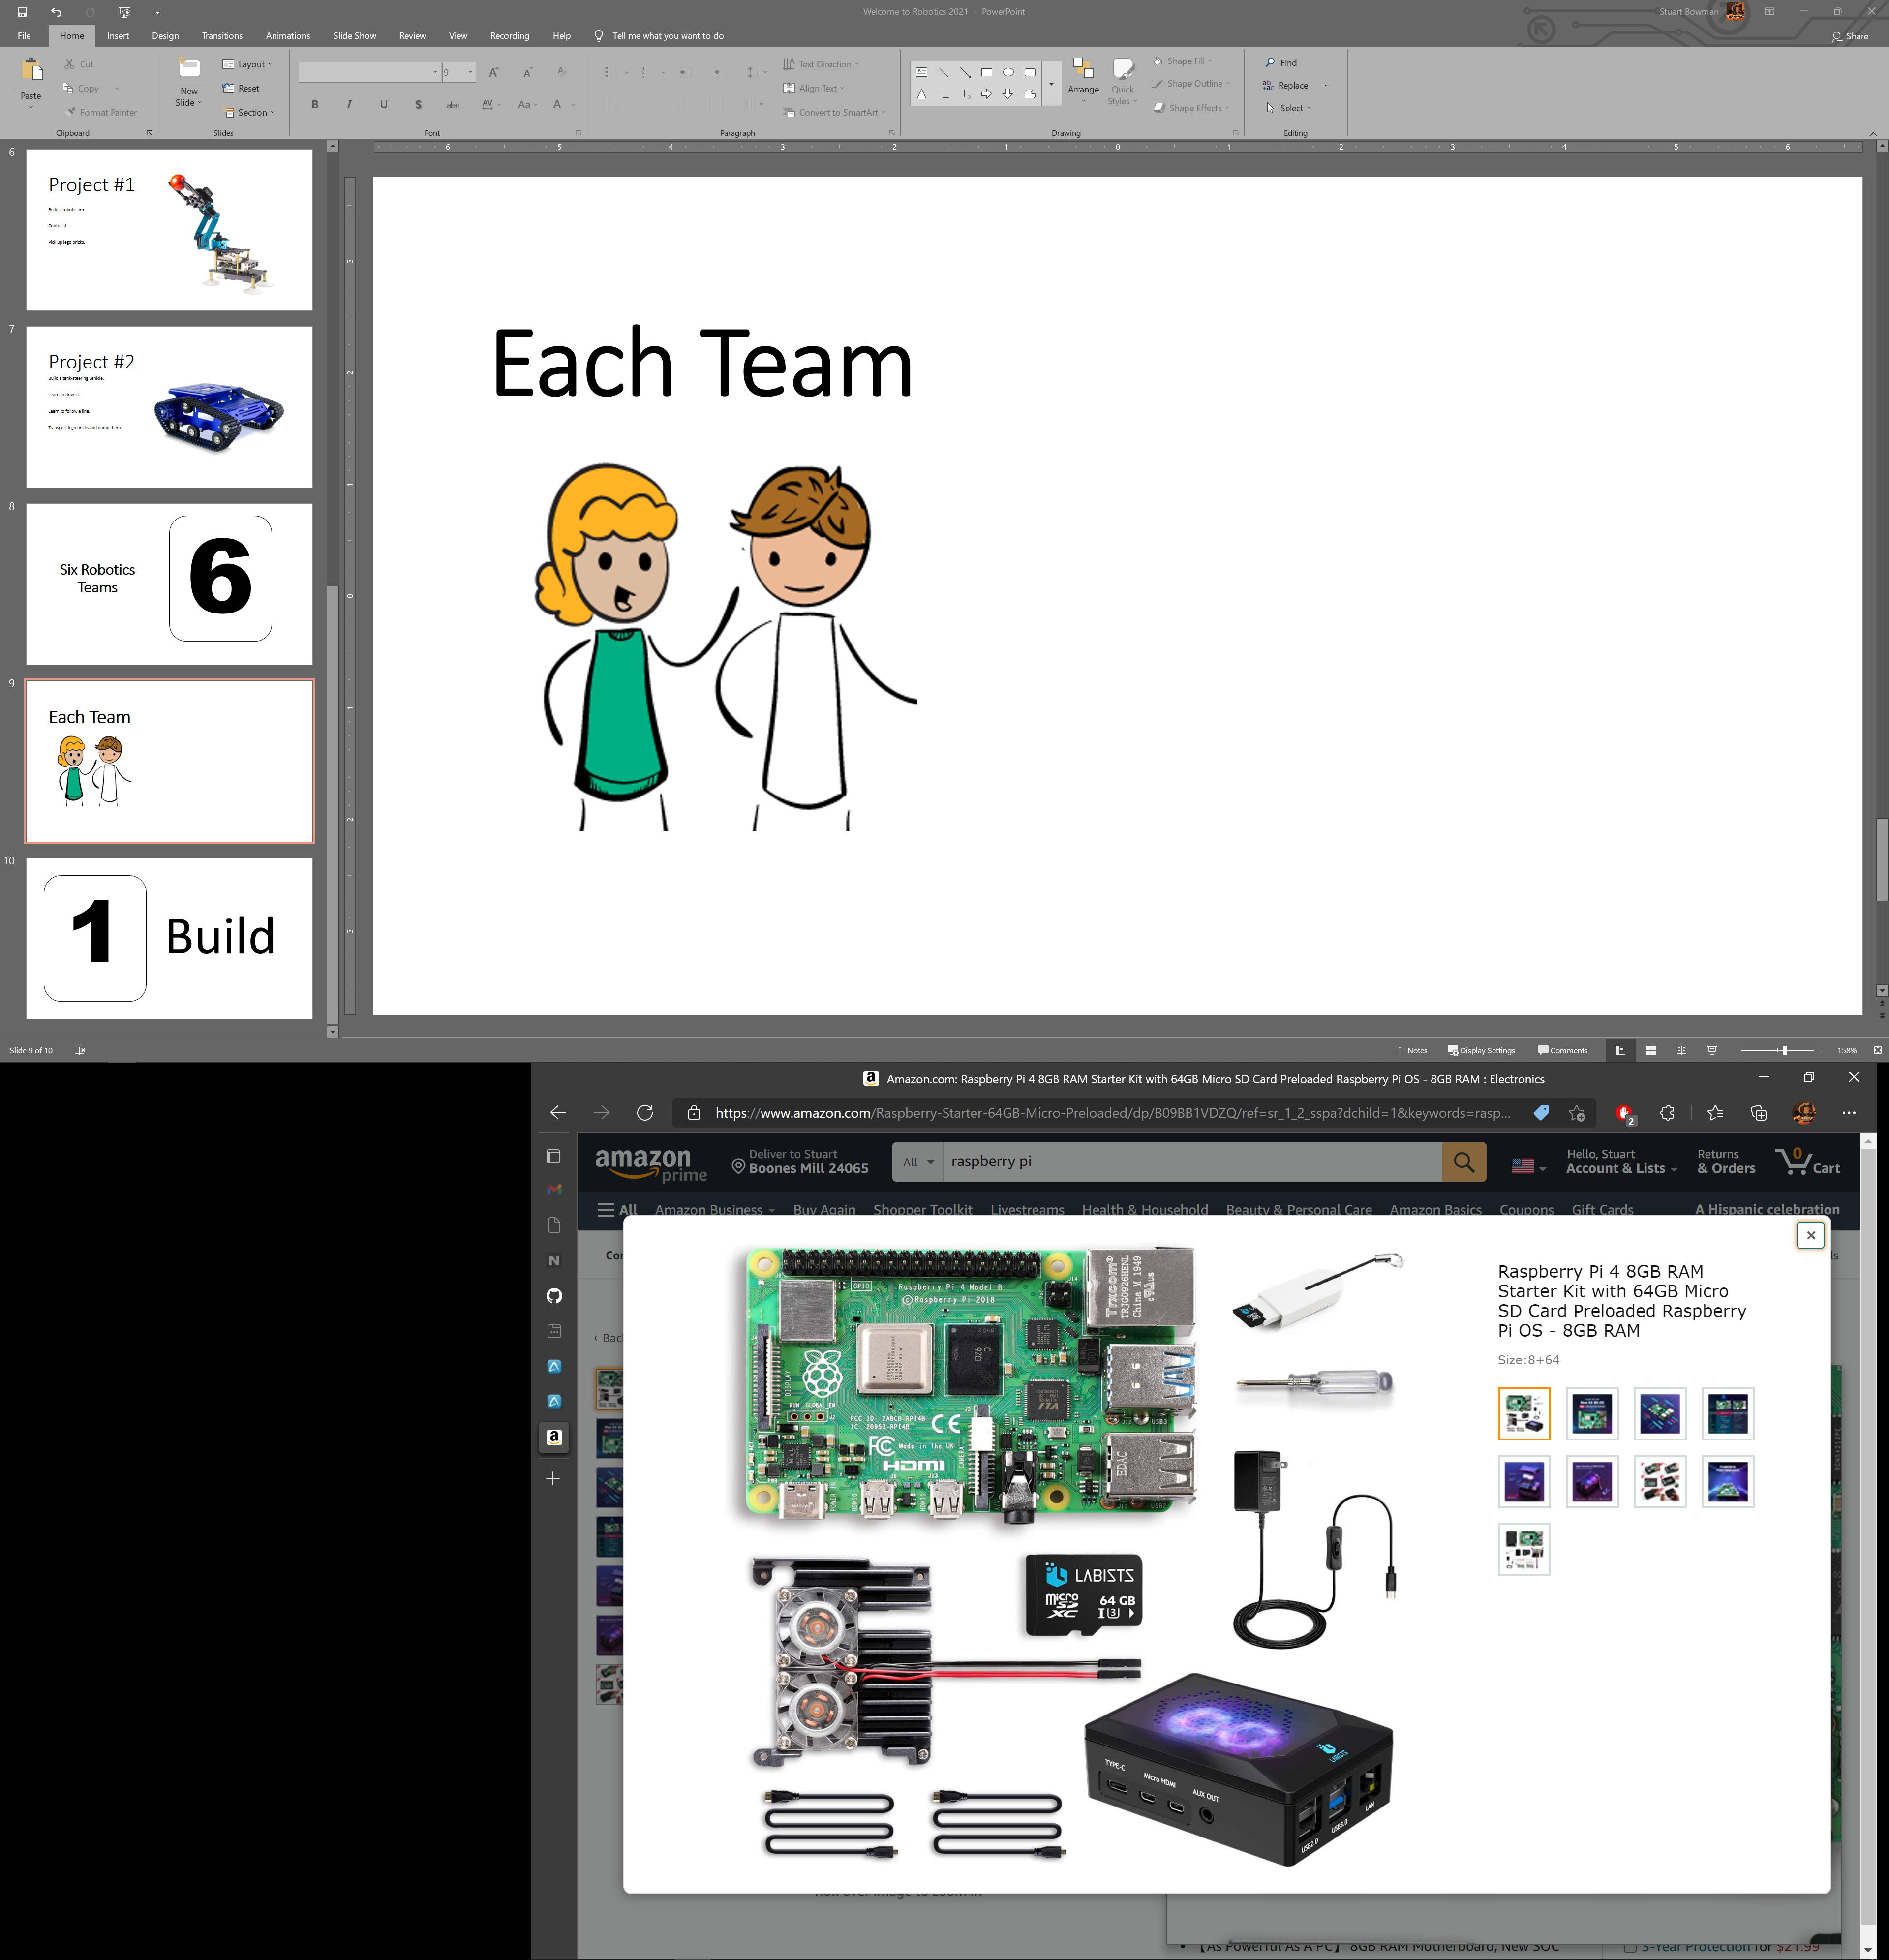

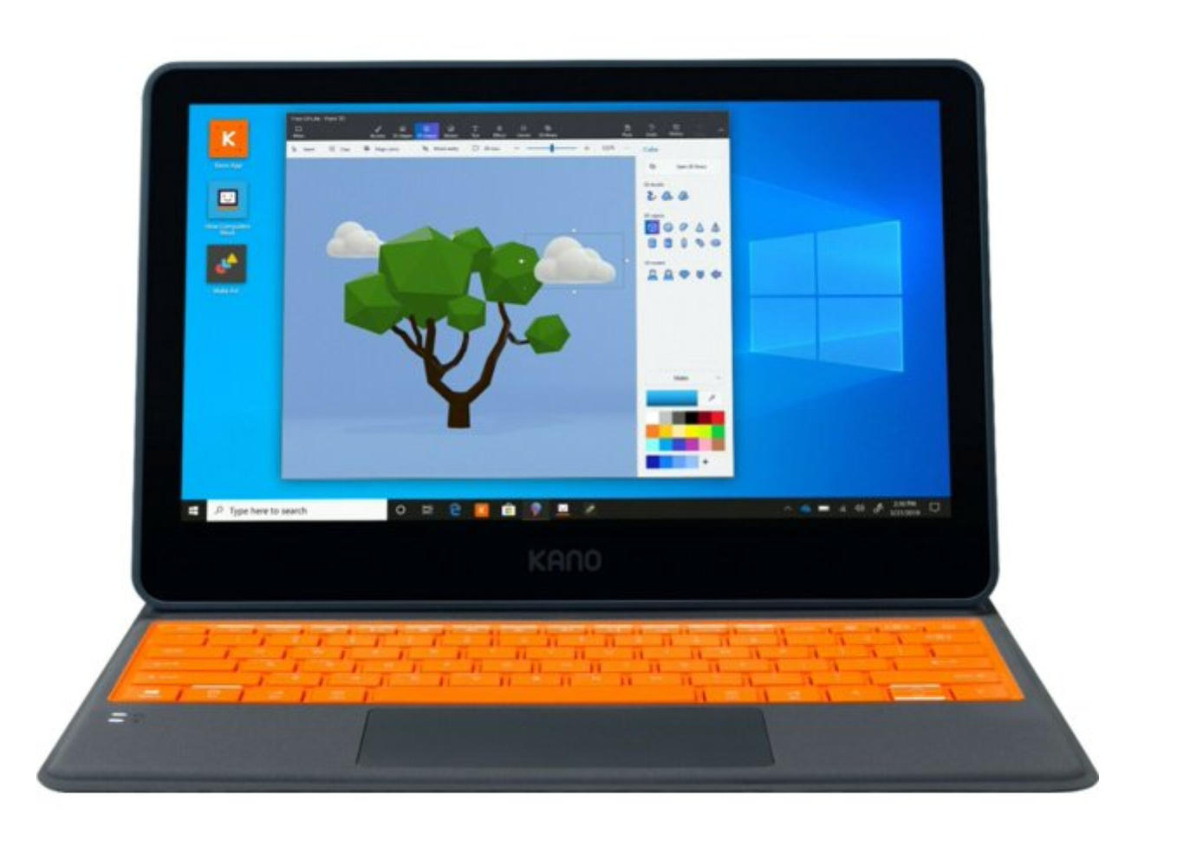
Each Team

Slide 10
But…

Slide 11
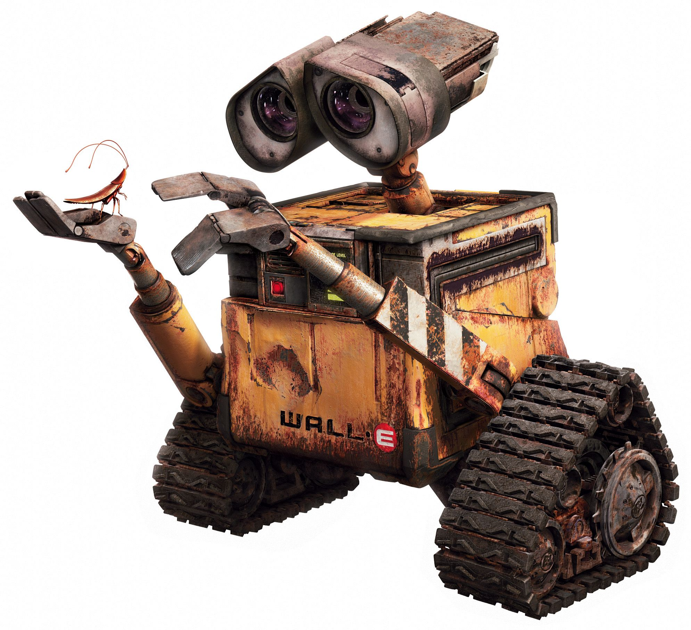
What Is A Robot?
We're comfortable with the idea of robots. Lots of images come to mind of examples we've seen, stories we've heard. The stories have been around for quite a while.

Slide 12
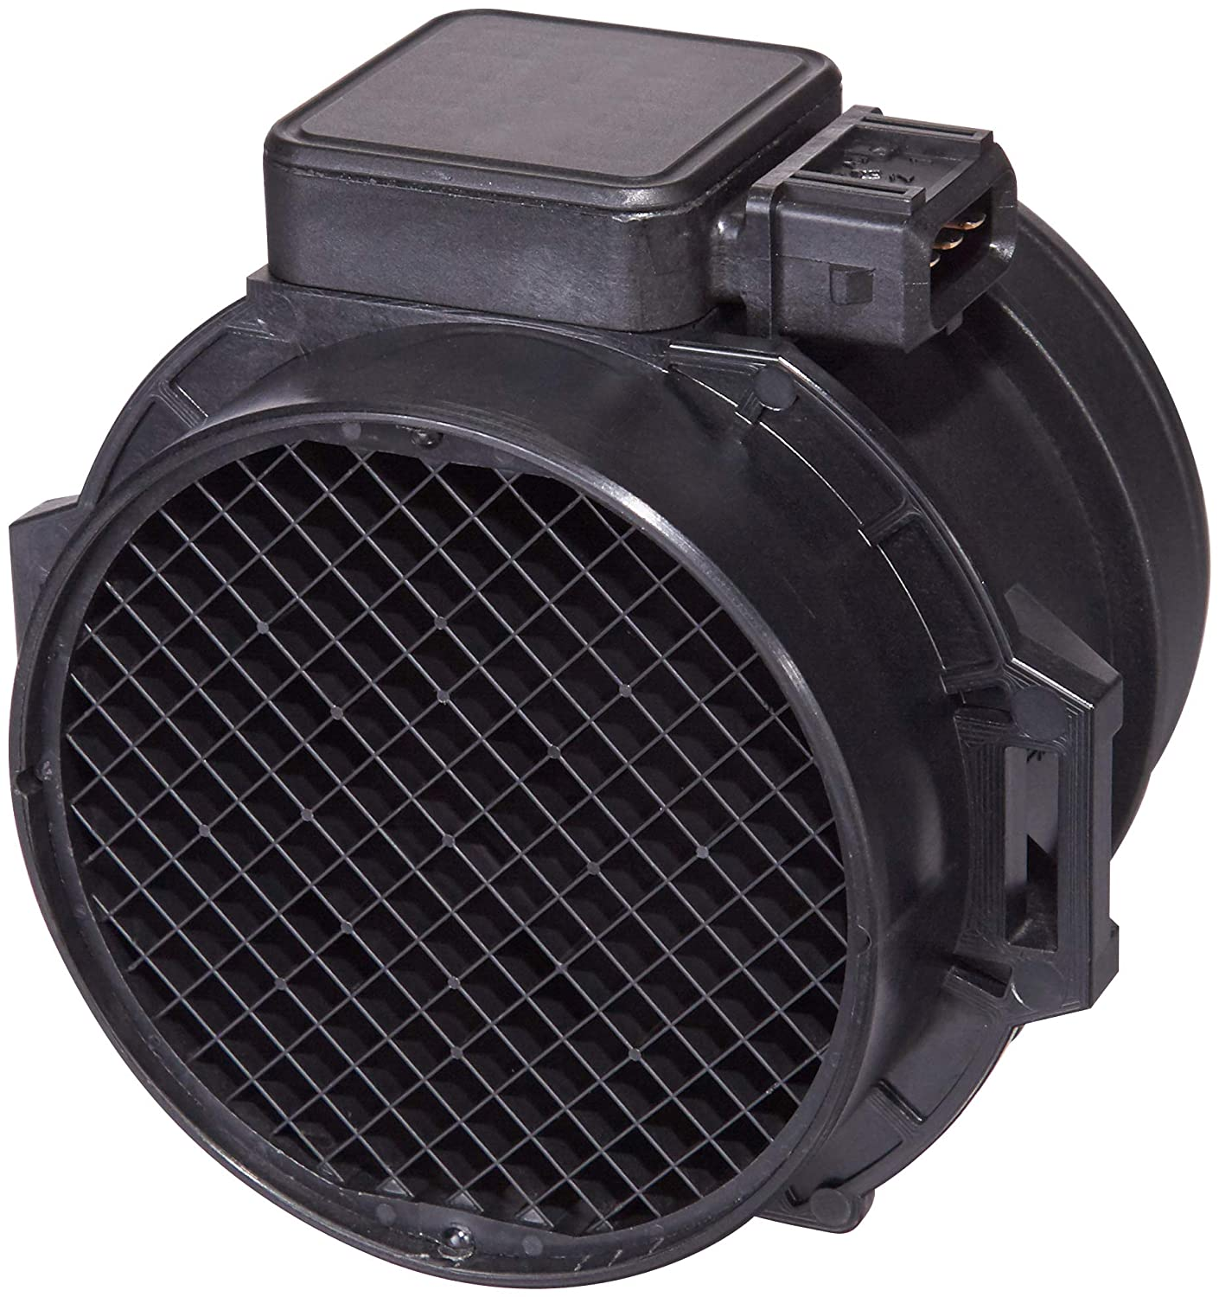
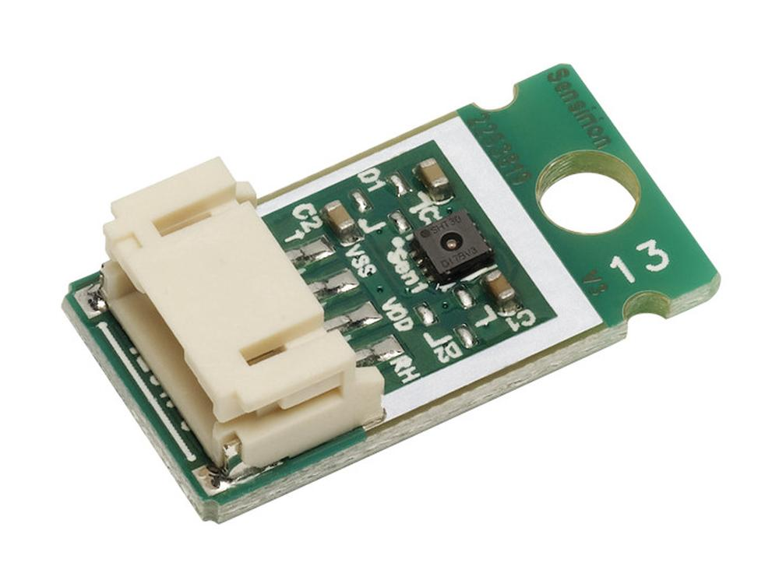
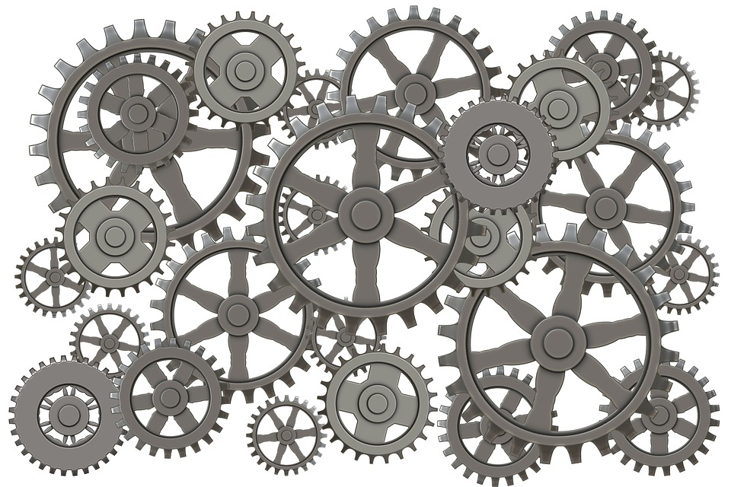
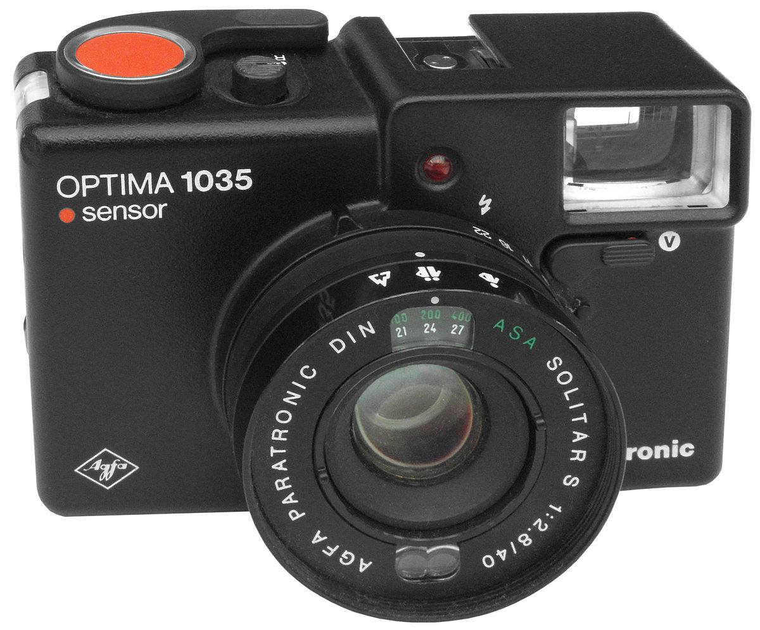
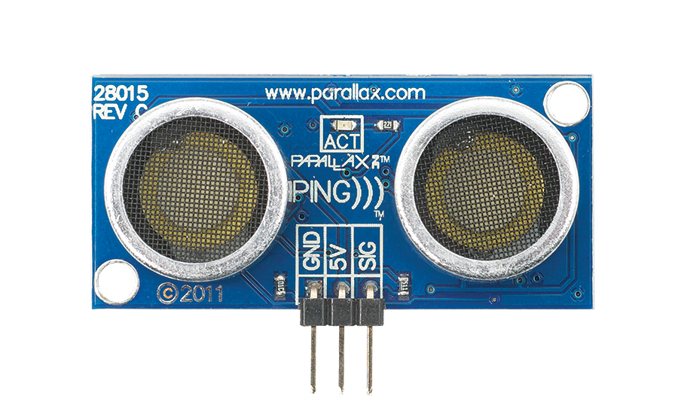
+
+
This Photo by Unknown Author is licensed under CC BY-SA

Slide 13
Robots Perform Their Own Tasks

Slide 14
Electronics
Mechanics
Software
Robots Use All Of These Together
Notes:
Robotics is a discipline: engineering + computer science.
The goal of robotics: design machines that operate autonomously to perform a complex task that humans normally do. The robot should be able to help & assist the human.

Slide 16
1
Build

